Slide 1

Finding Best POIs
Wonho Choi

Slide 2


Finding best POIs
Living in a large city can have its disadvantages when it comes to deciding on places to conduct business. Fortunately, we are able to draw conclusions faster thanks to the experiences and service received by other consumers.

Slide 3



Tools Used
import pandas as pd
import os
import requests
import json
import sqlite3 as sqlite
import sqlalchemy

Slide 4

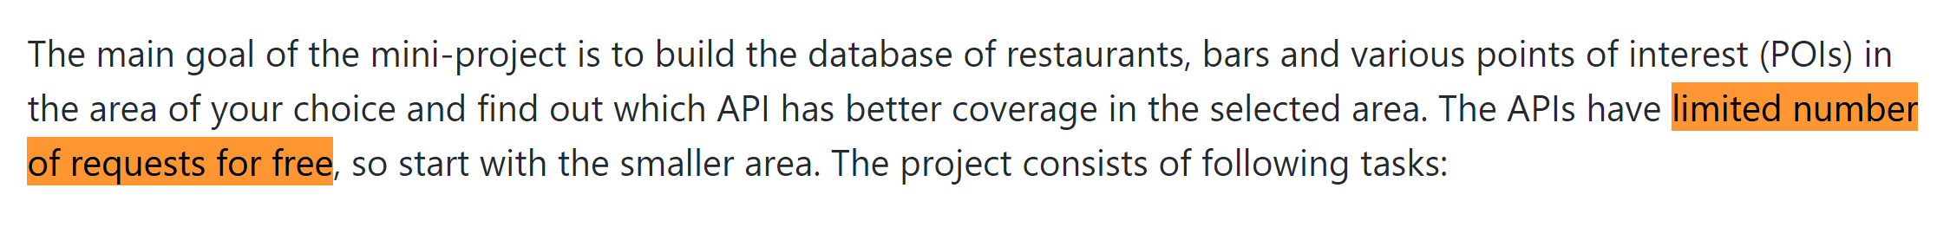
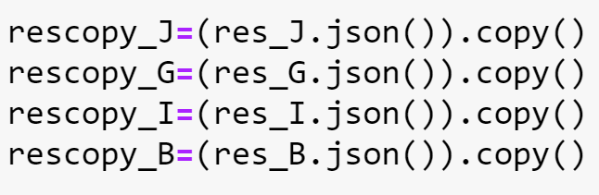
How many requests do you need to send while getting enough results for the
large data collection?
Tip
In order to minimize the use of requests and maximize the amount of interactions with data, I made our modern RAM to do most of the jobs!

Slide 5
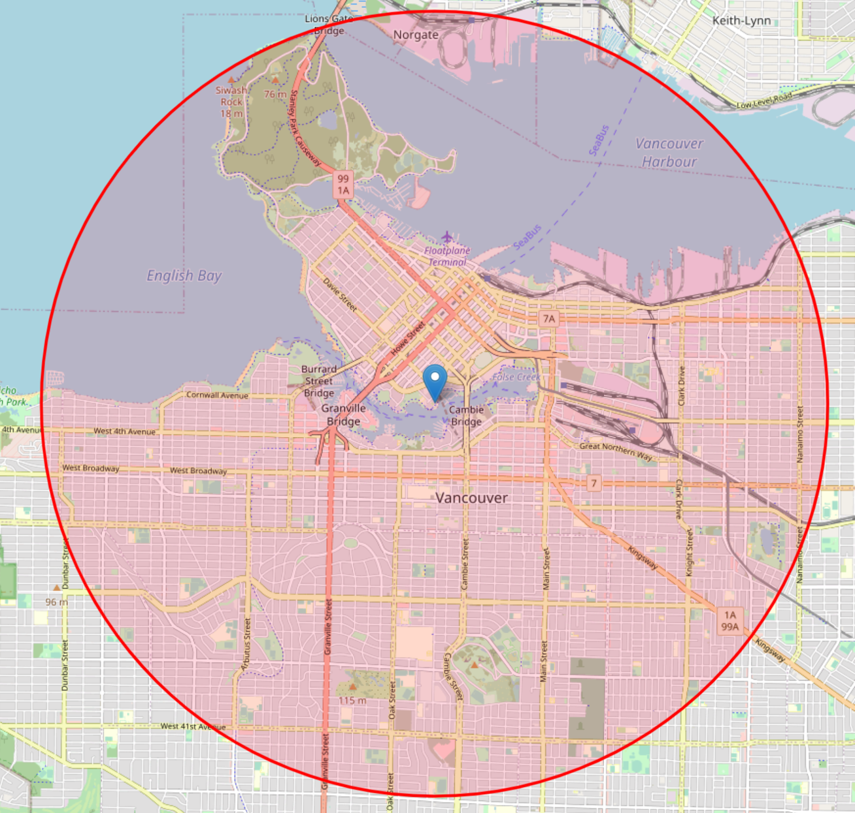

Location: Yaletown, Vancouver
49.2757°N, 123.1199°W
radius=5000M

Slide 6



We are looking at Three different categories of POIs

Slide 7
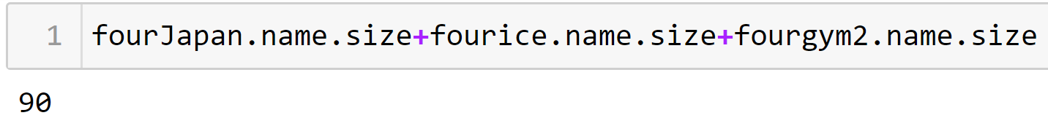

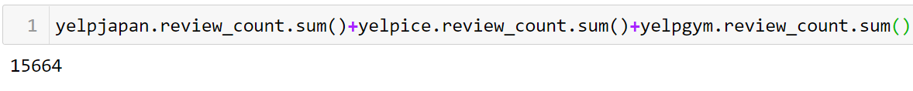
Listings
90 > 60
Ratings
4,496 < 15,664

Slide 8
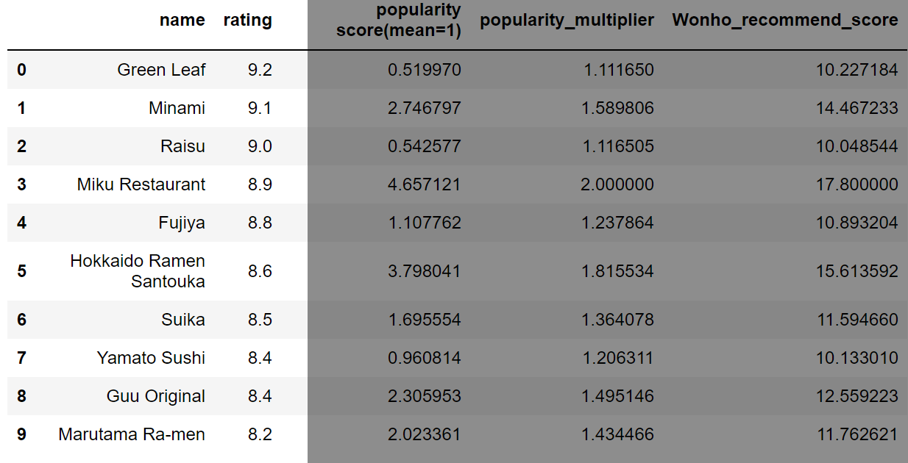
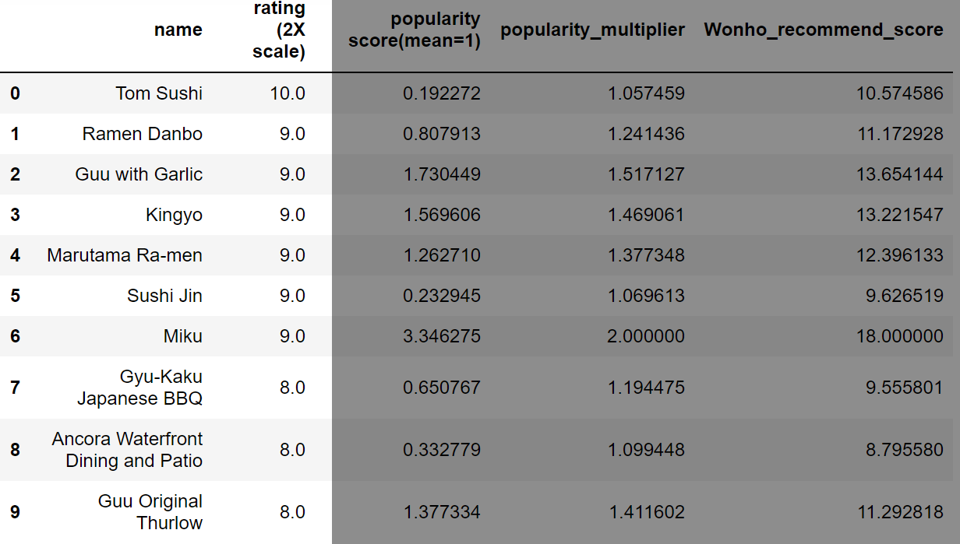
.sort_values(by='rating')
.sort_values(by='rating')
Problems:
Ratings
Don’t represent the entirety
of customers’ opinions.
Popularity
Is important too.
Solution:
Popularity score
(rating count)/count.mean()
Popularity_multiplier
1+(rating count/count.max())
Wonho_recommend_score
popularity_multiplierXrating

Slide 9
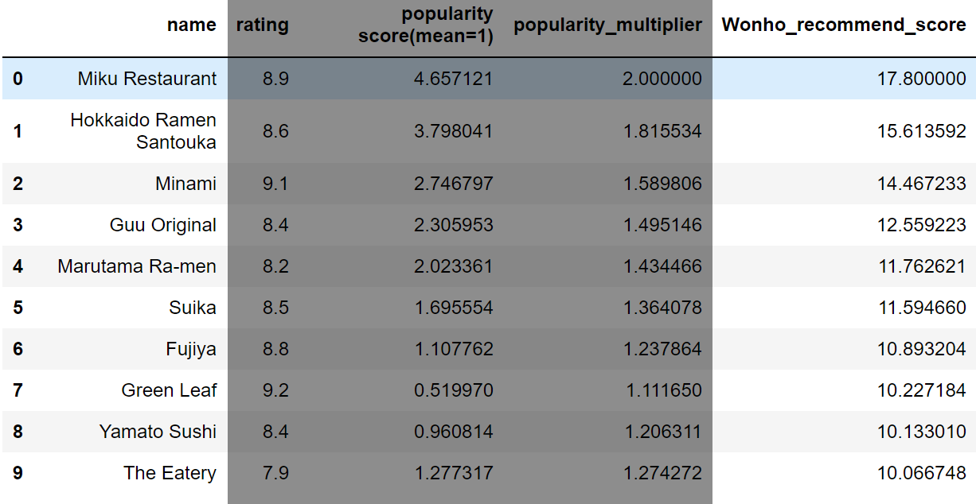
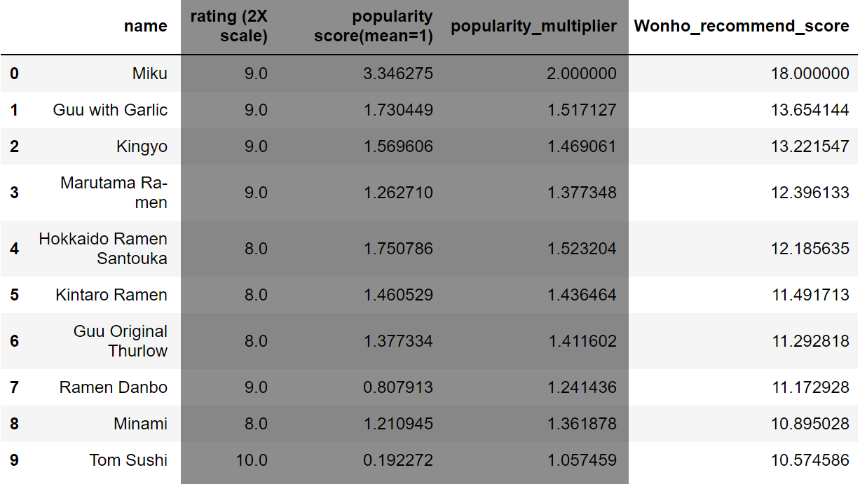
.sort_values(by='Wonho_recommend_score')
.sort_values(by='Wonho_recommend_score')
Result
Now the rankings seem to be more consistent,
Two tables have better overlaps

Slide 10

Rank 1. Miku

Slide 11
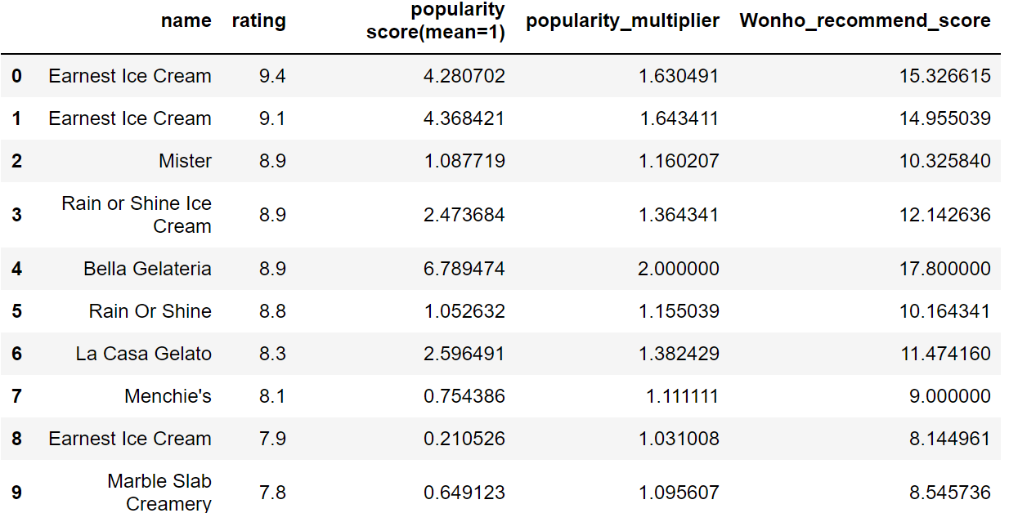
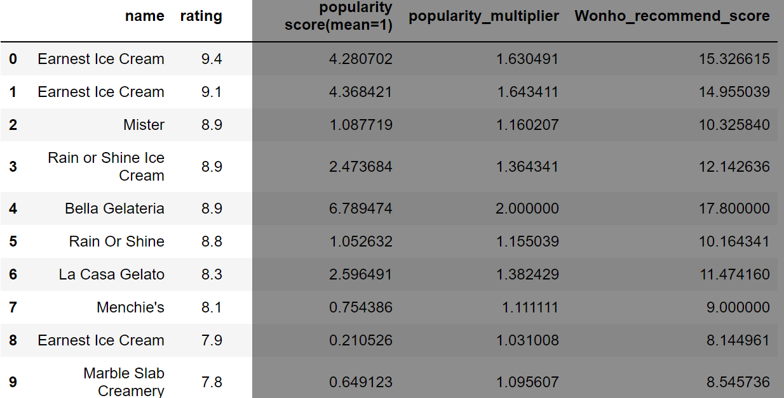
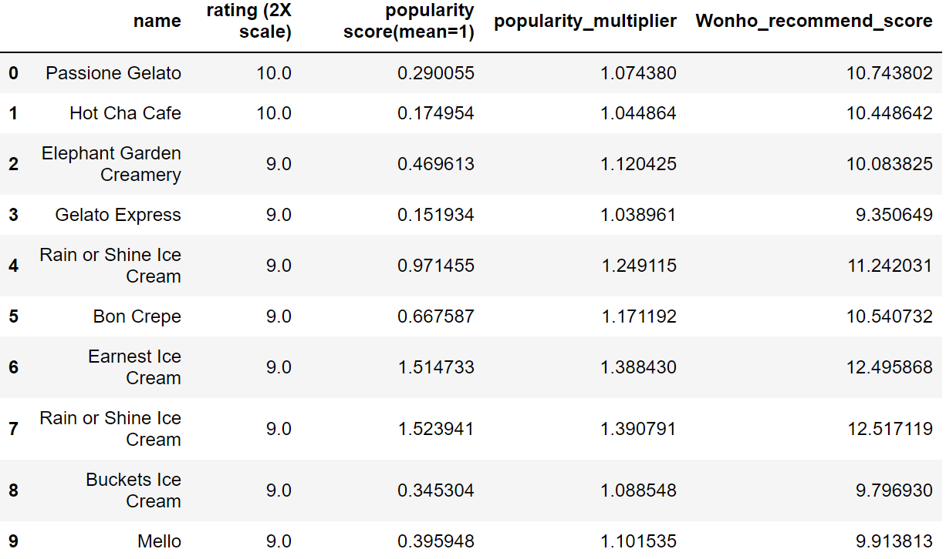
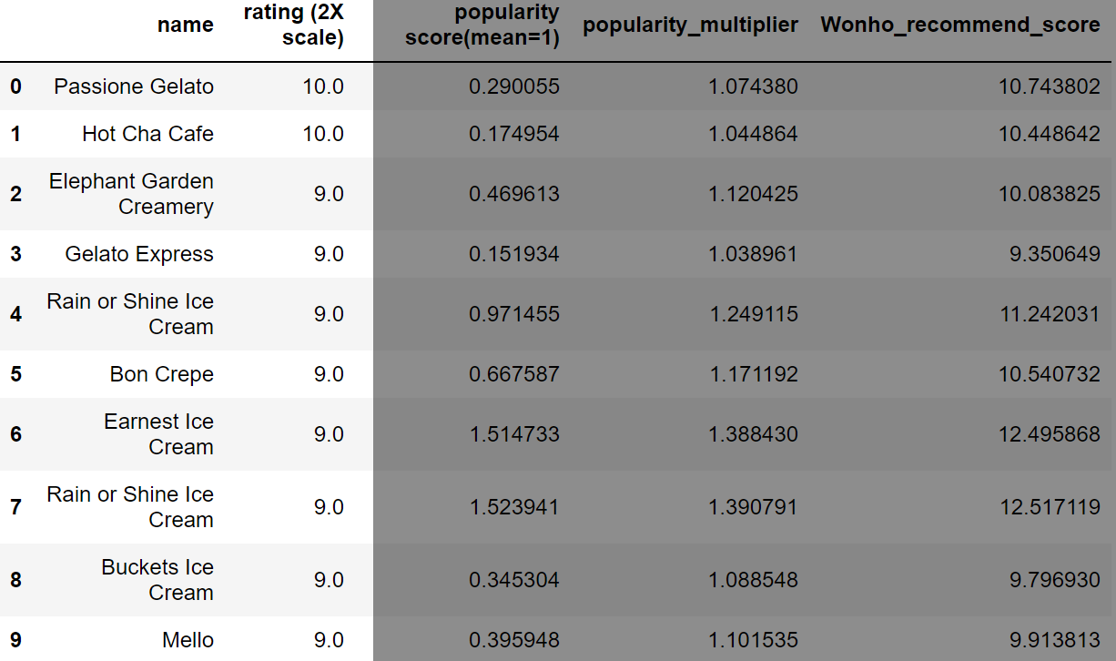
.sort_values(by='rating')
.sort_values(by='rating')
Problems:
Ratings
don’t represent the entirety
of customers’ opinions.
Popularity
matters too.
Solution:
Popularity score
(rating count)/count.mean()
Popularity_multiplier
1+(rating count/count.max())
Wonho_recommend_score
popularity_multiplierXrating

Slide 12
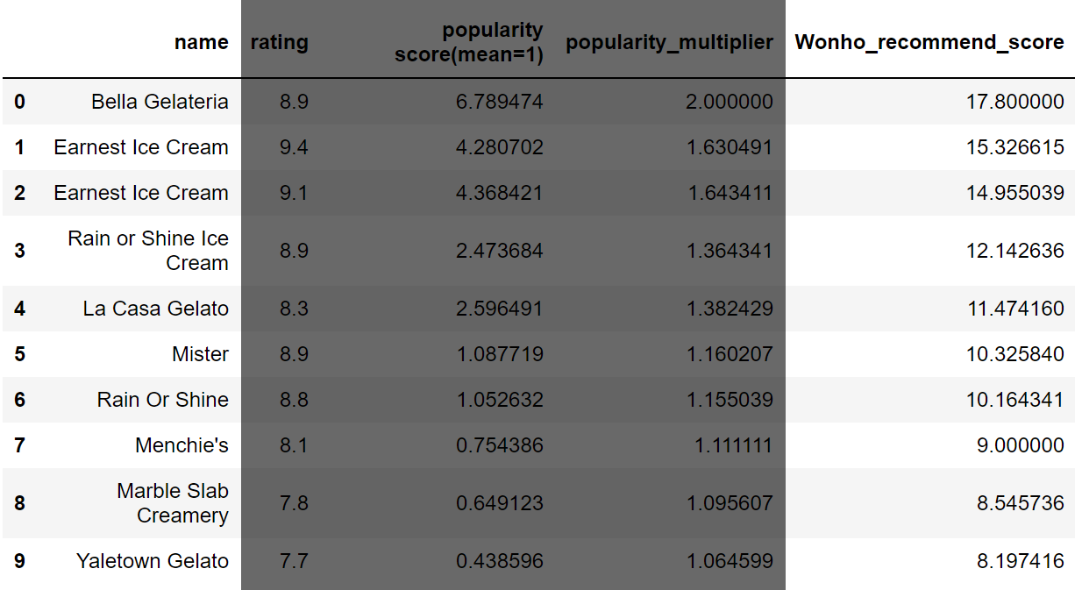
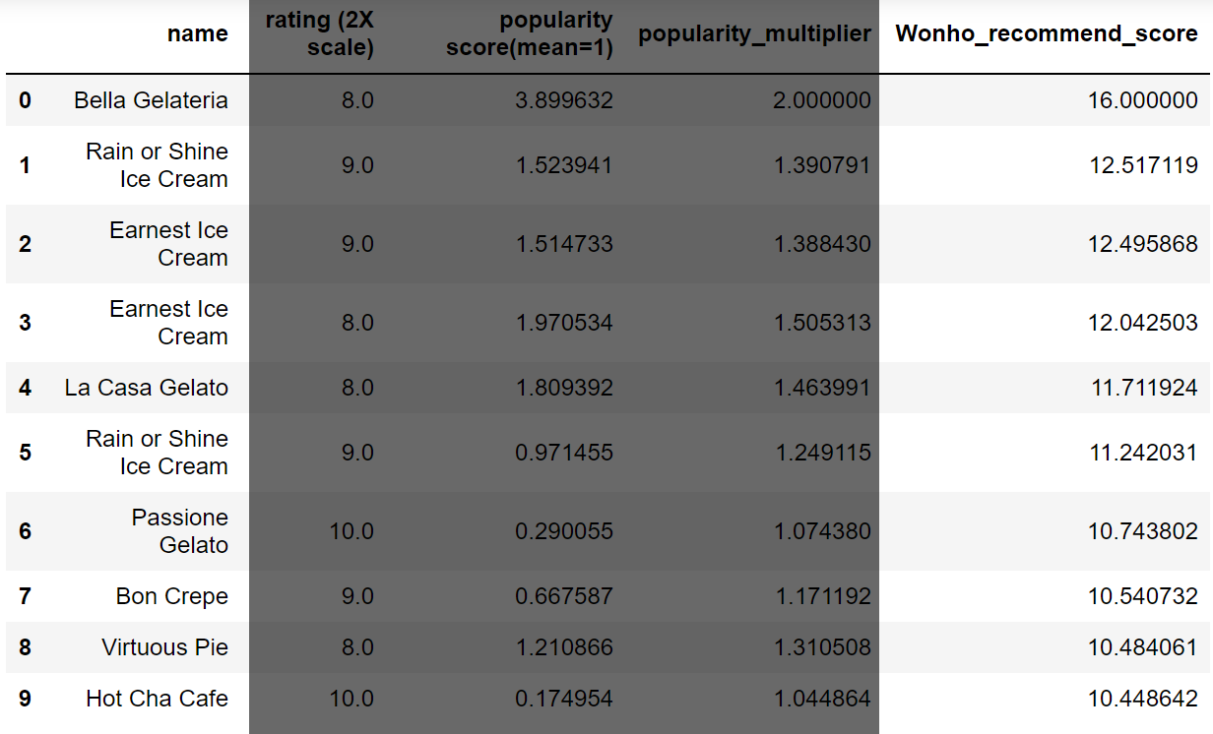
.sort_values(by='Wonho_recommend_score')
.sort_values(by='Wonho_recommend_score')
Result
Now the rankings seem to be more consistent,
Two tables have better overlaps

Slide 13

Rank 1. Miku Rank 1. Bella Gelateria

Slide 14
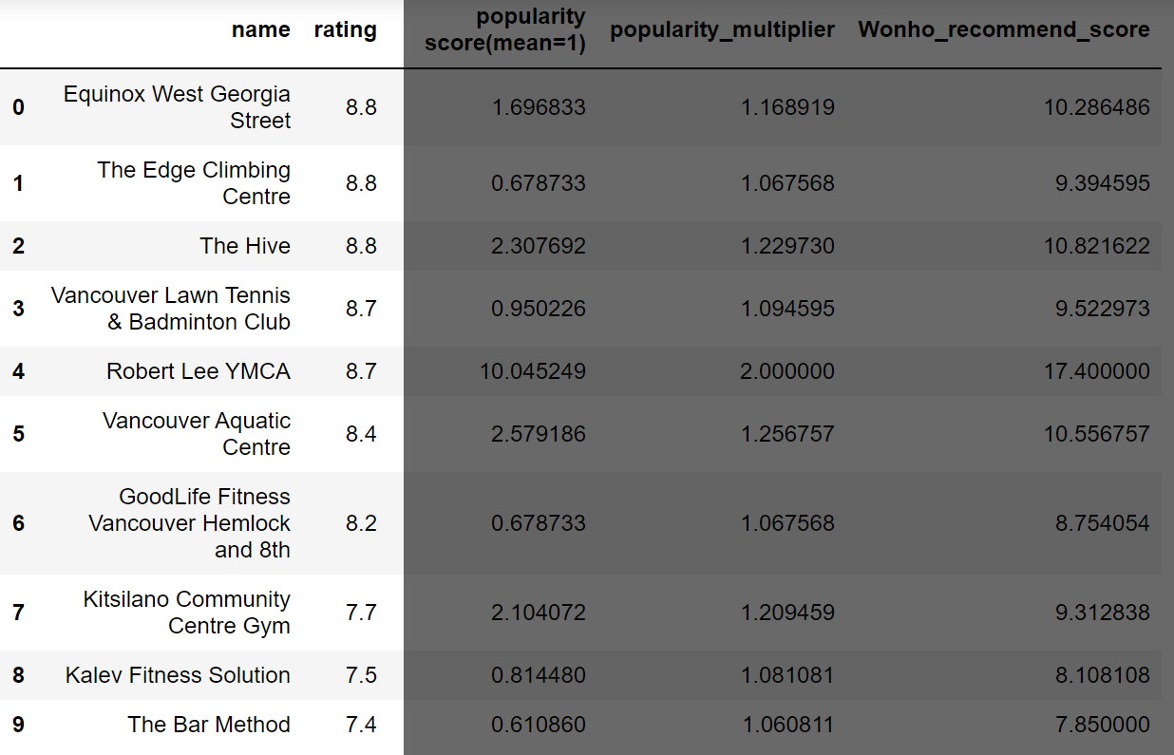
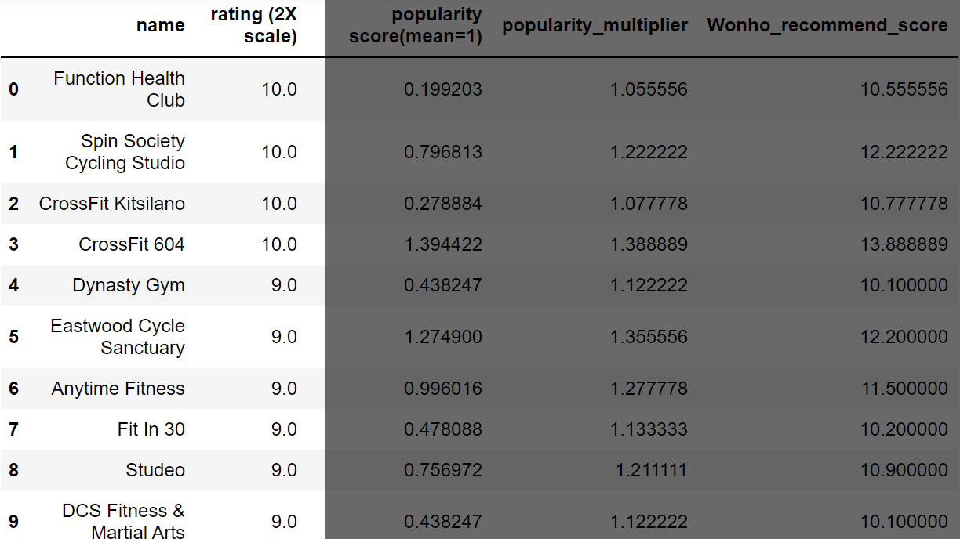
.sort_values(by='rating')
.sort_values(by='rating')
Problems:
Ratings
don’t represent the entirety
of customers’ opinions.
Popularity
matters too.
Solution:
Popularity score
(rating count)/count.mean()
Popularity_multiplier
1+(rating count/count.max())
Wonho_recommend_score
popularity_multiplierXrating

Slide 15
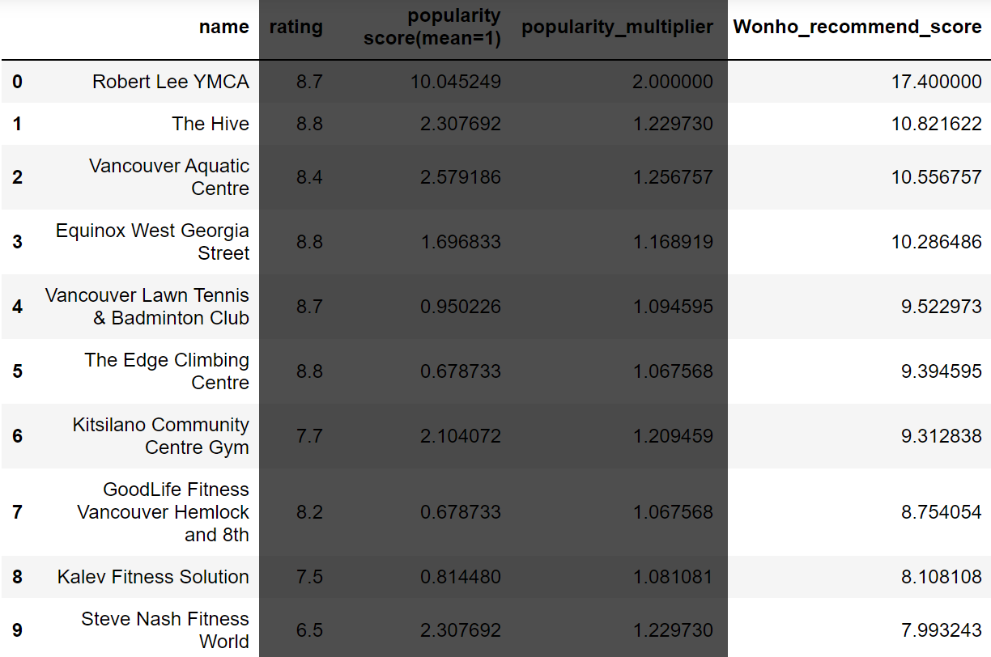
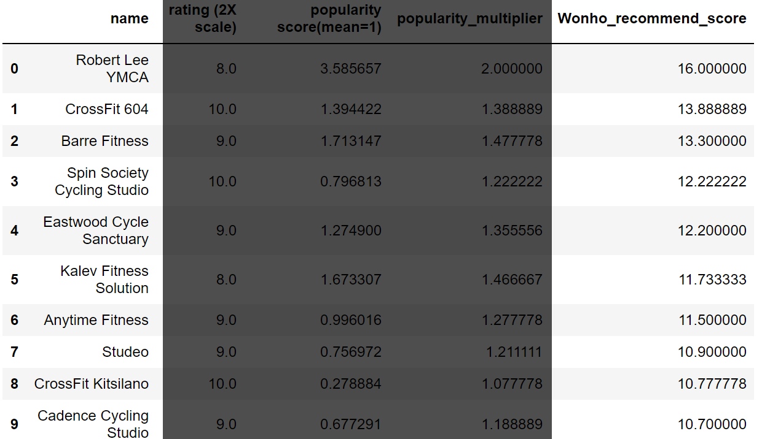
.sort_values(by='Wonho_recommend_score')
.sort_values(by='Wonho_recommend_score')
Result
Now the rankings seem to be more consistent,
Two tables have better overlaps

Slide 16

Rank 1. Miku Rank 1. Bella Gelateria Gym

Slide 17
Which is better?
Data
>
API
<

Slide 18
